Slide 1
Intro to Pointers
* →&

Slide 2
What are Pointers?
Every variable has an address that corresponds to the memory location for that variable.
A Pointer is a variable that stores another variable’s address instead of a particular value.
Var 2
Var 1
bff3e2f2
12
bff6d322
bff3e2f2

Slide 3
Making Pointers
To create a pointer the following generalized syntax is used:
type *var_name;
“type” would be the type of whatever variable is being pointed to
‘*’ designates the variable as a pointer
This is an example of how to initialize a pointer:
int x = 12;
int *ptr = NULL;
ptr = &x;
Note: the ‘&’ makes it so ptr is set to the address of x and not the value of x

Slide 4
A Simple Example
int *ptr;
int x;
ptr = &x;
Int x = 12;
???
bff4e837
bff6w232
bff4e837
bff6w232
bff6w232
12
bff4e837
bff6w232

Slide 5
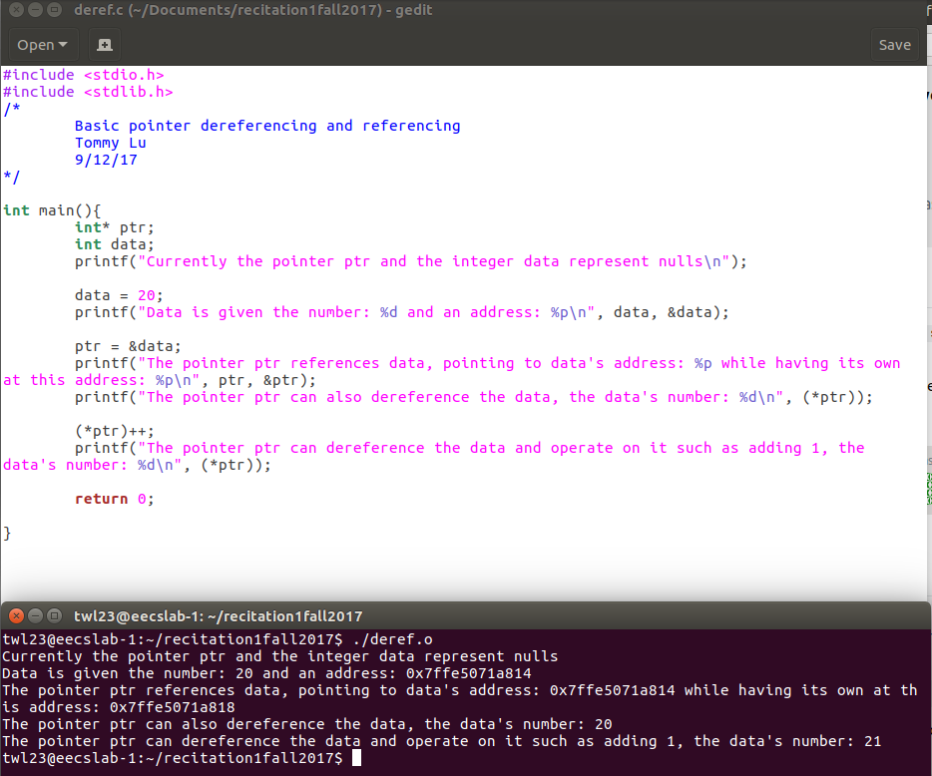
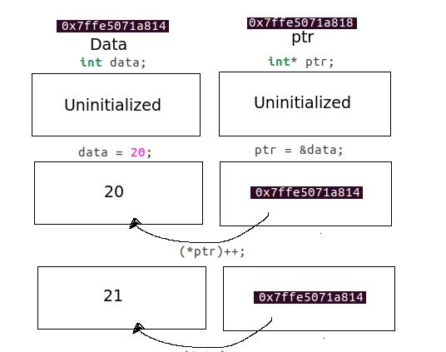
Referencing and Dereferencing

Slide 6
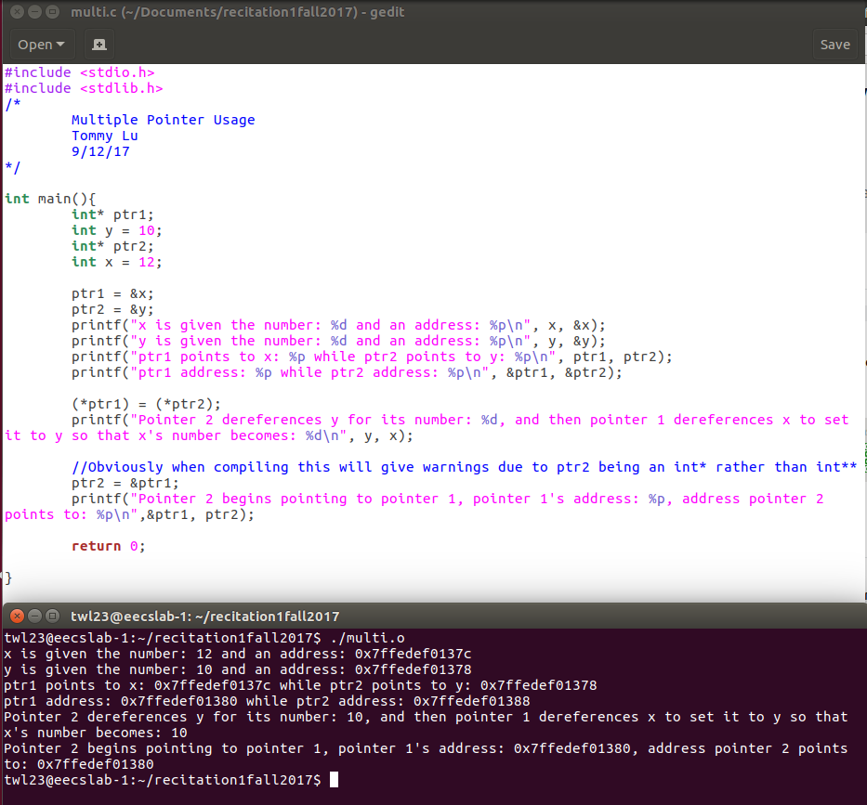
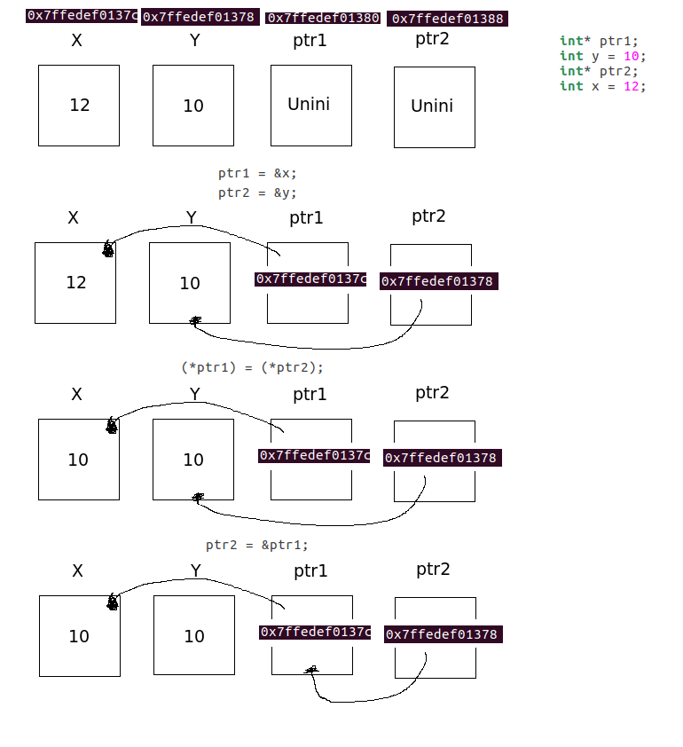
Working with Multiple Pointers Example

Slide 7
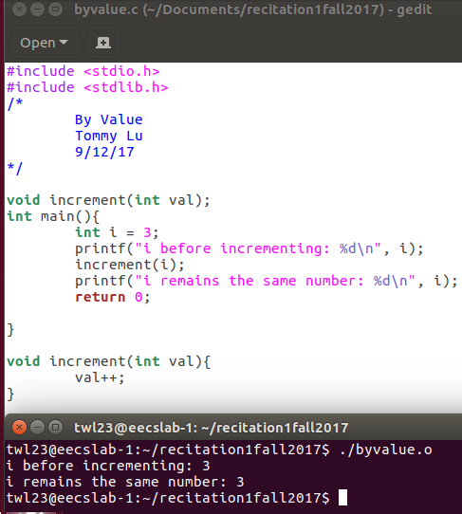
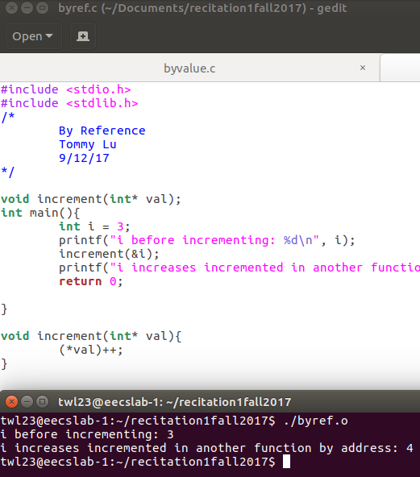
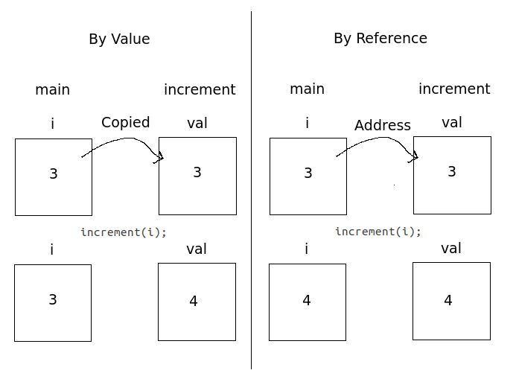
By Value Versus by Reference

